Slide 1


INSTITUTE FOR ADVANCED COMPUTING AND SOFTWARE DEVELOPMENT AKURDI, PUNE
"Secure building Web Applications with CI/CD pipeline using Git, Jenkins, and DockerHub"
GROUP NO: 16
Kaustubh Veer 233413
Gaurav R Jadhav 233412
Mr. Kartik Awari Mr. Rohit Puranik
PROJECT GUIDE CENTRE CO-ORDINATOR

Slide 2
Introduction
X`The number one reason to do DevOps is code quality, and the number one process teams need for DevOps is CI/CD. Because CI/CD pipelines offer test automation, developers can know about code problems in nearly real-time. That concept of “failing fast” means teams aren’t wasting time or resources with buggy code, and devs aren’t plagued with endless “fix” requests when they’ve moved on to other projects. Time is saved, money is saved, and developers aren’t endlessly context-switching. A unified CI/CD pipeline is like a turbo engine when it comes to boosting the rate of software releases. The faster code is released, the more new code can be developed and released ad infinitum. The business bottom line: Expensive developer resources are active when a successful CI/CD pipeline is in play.
CI/CD is a system that can merge new lines of code with the old system while checking for mistakes or possible bugs. It makes it easier to release new updates with fewer mistakes. It also makes it possible to release updates continuously in a way never possible before.

Slide 3
PURPOSE
CI/CD allows organizations to ship software quickly and efficiently. CI/CD facilitates an effective process for getting products to market faster than ever before, continuously delivering code into production, and ensuring an ongoing flow of new features and bug fixes via the most efficient delivery method.

Slide 4
Requirement
Software
1. Operating system: Debian 10
2. Firewall: IPtables
3. Platform: Amazon Web Service
4. CI Platform : Jenkins
5. Database: Mariadb
Hardware
CPU 2.5GHz
RAM 8GB
Storage 500GB
Network 100Mbps

Slide 5
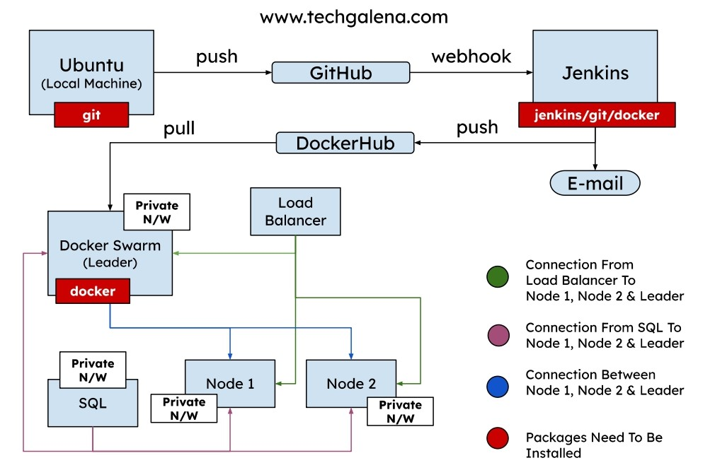
Architecture

Slide 6
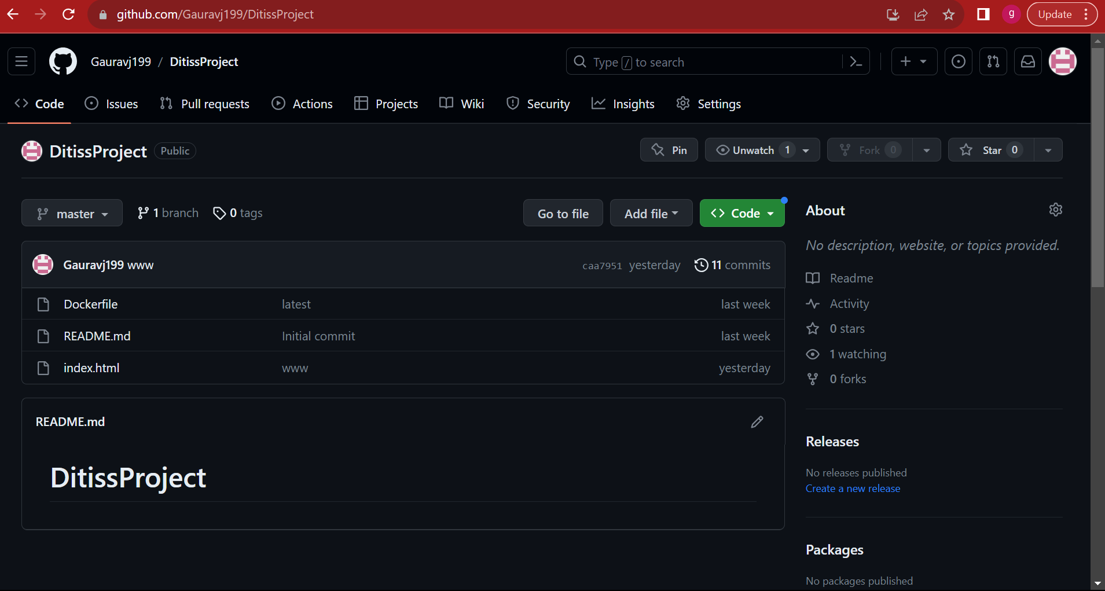

Slide 7
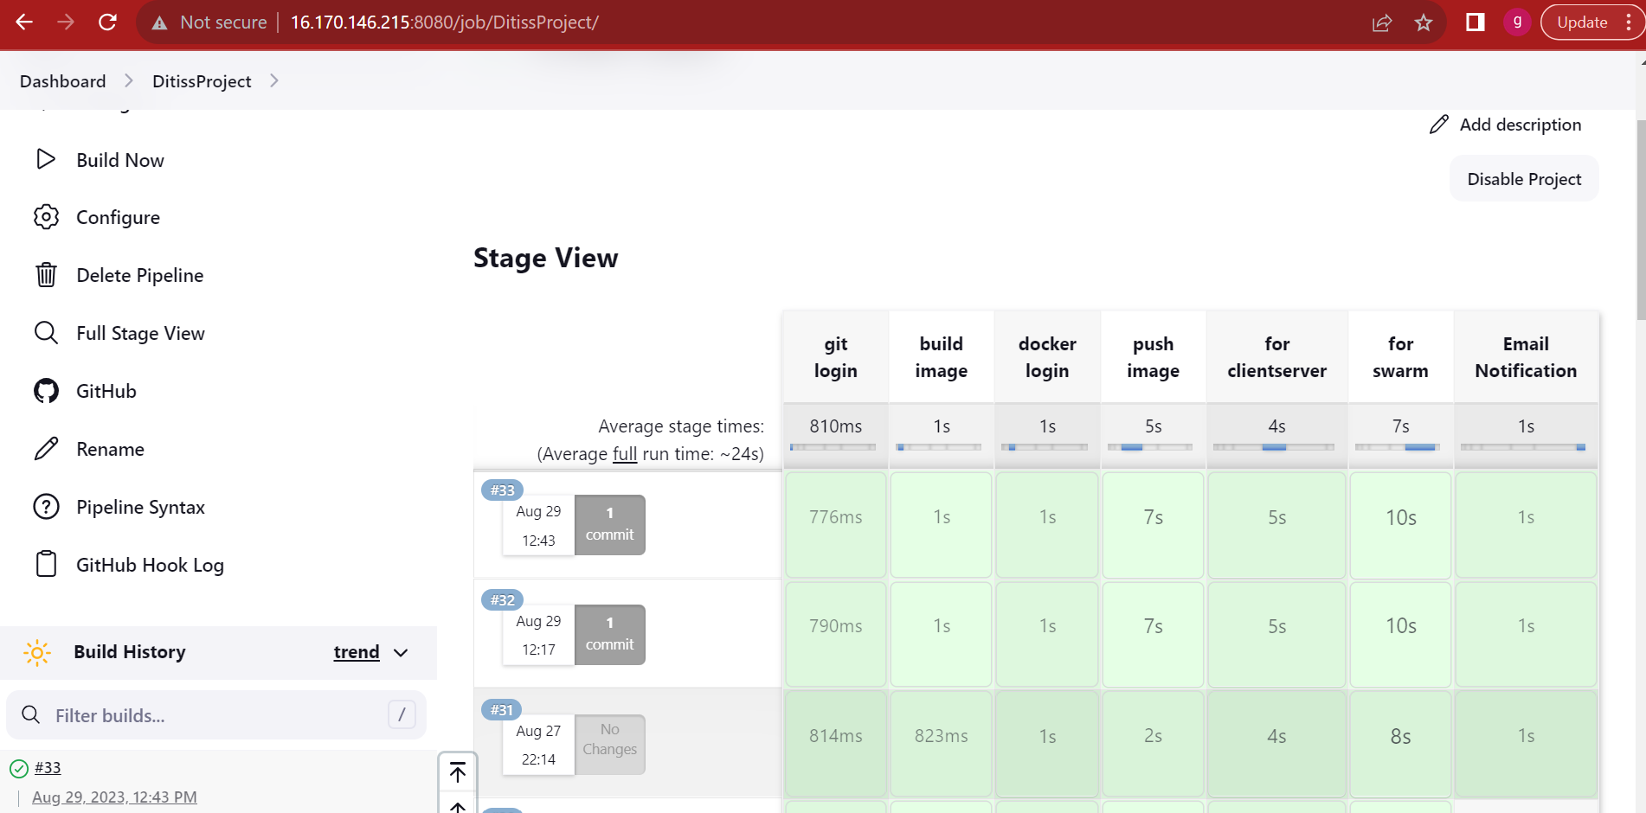

Slide 8
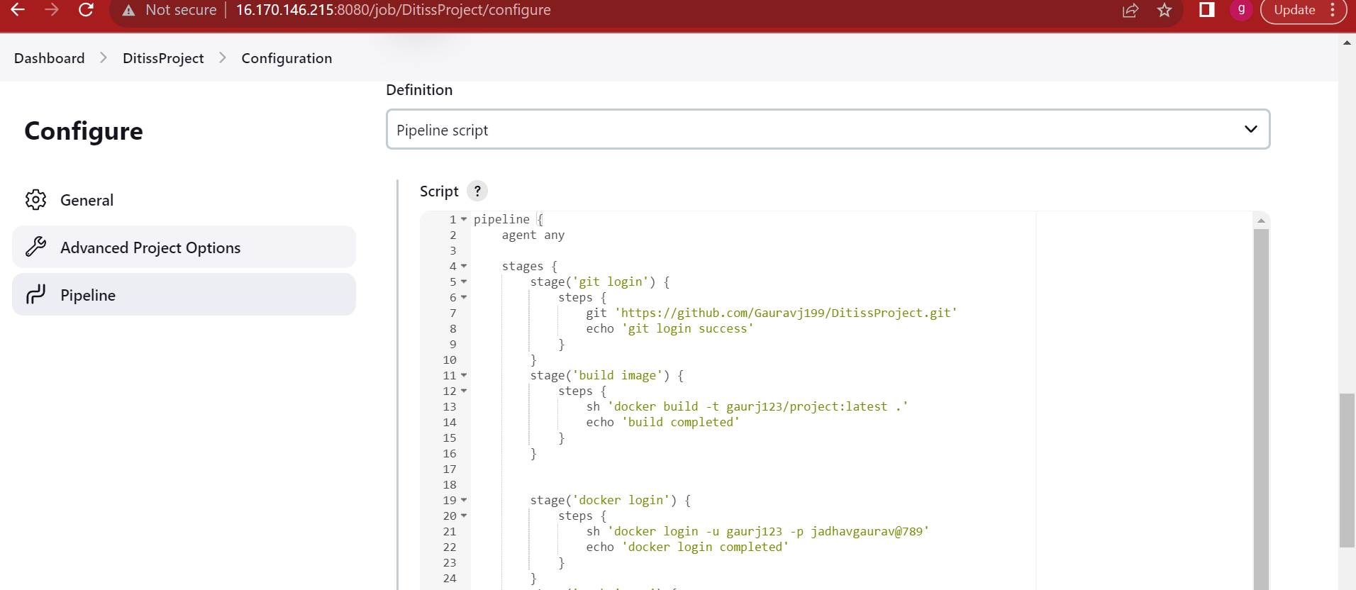

Slide 9
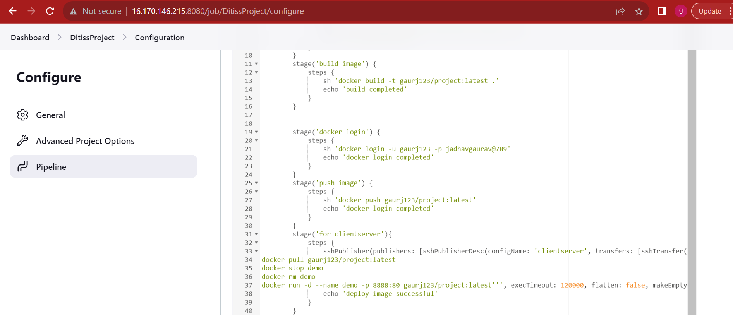

Slide 10
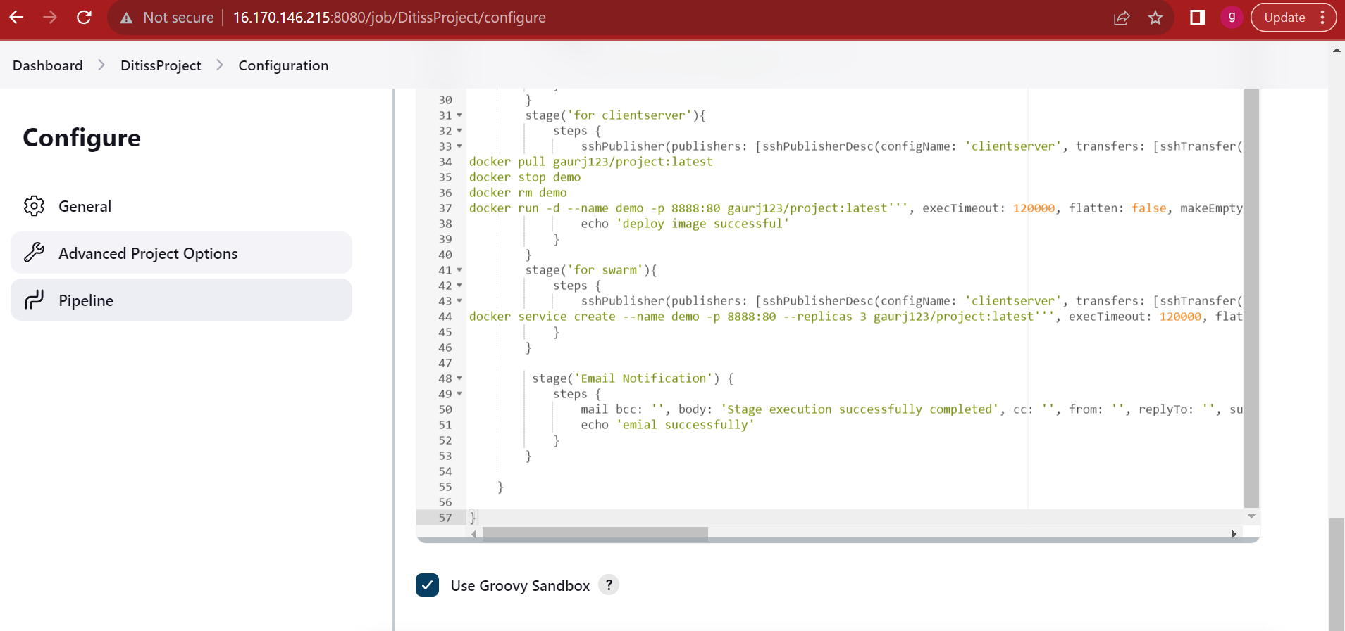

Slide 11
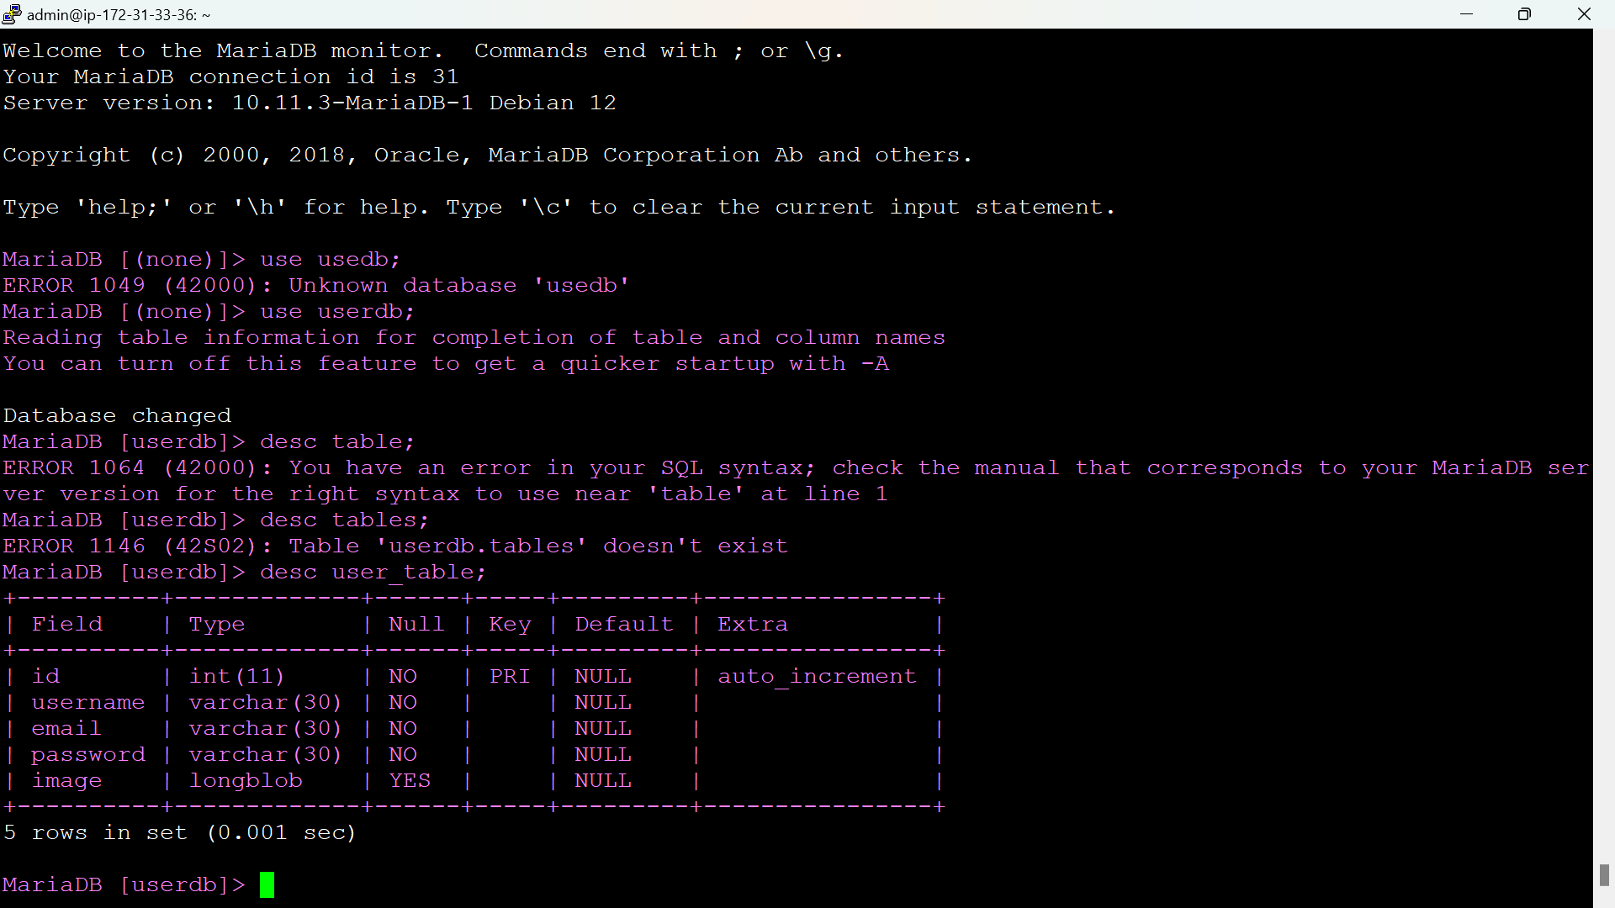

Slide 12
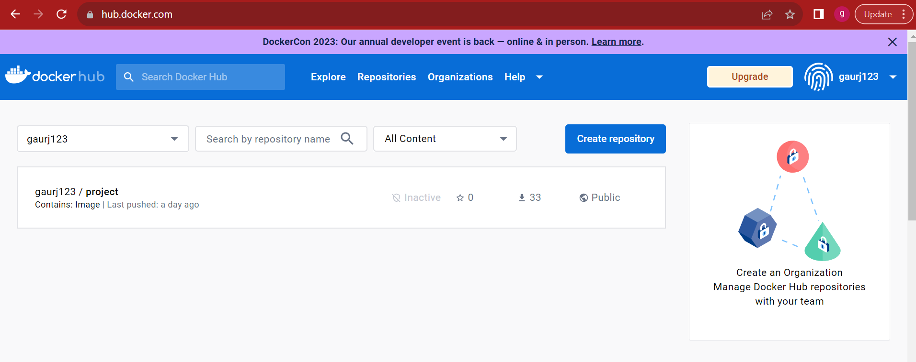

Slide 13
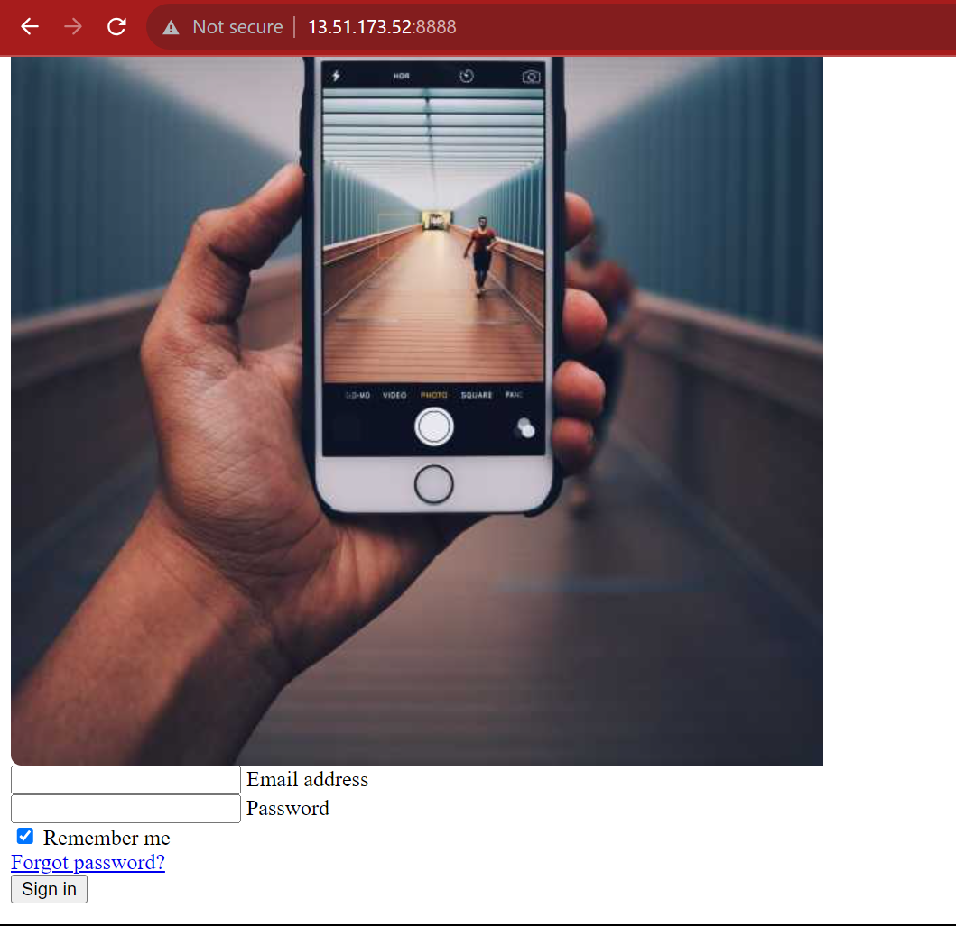

Slide 14
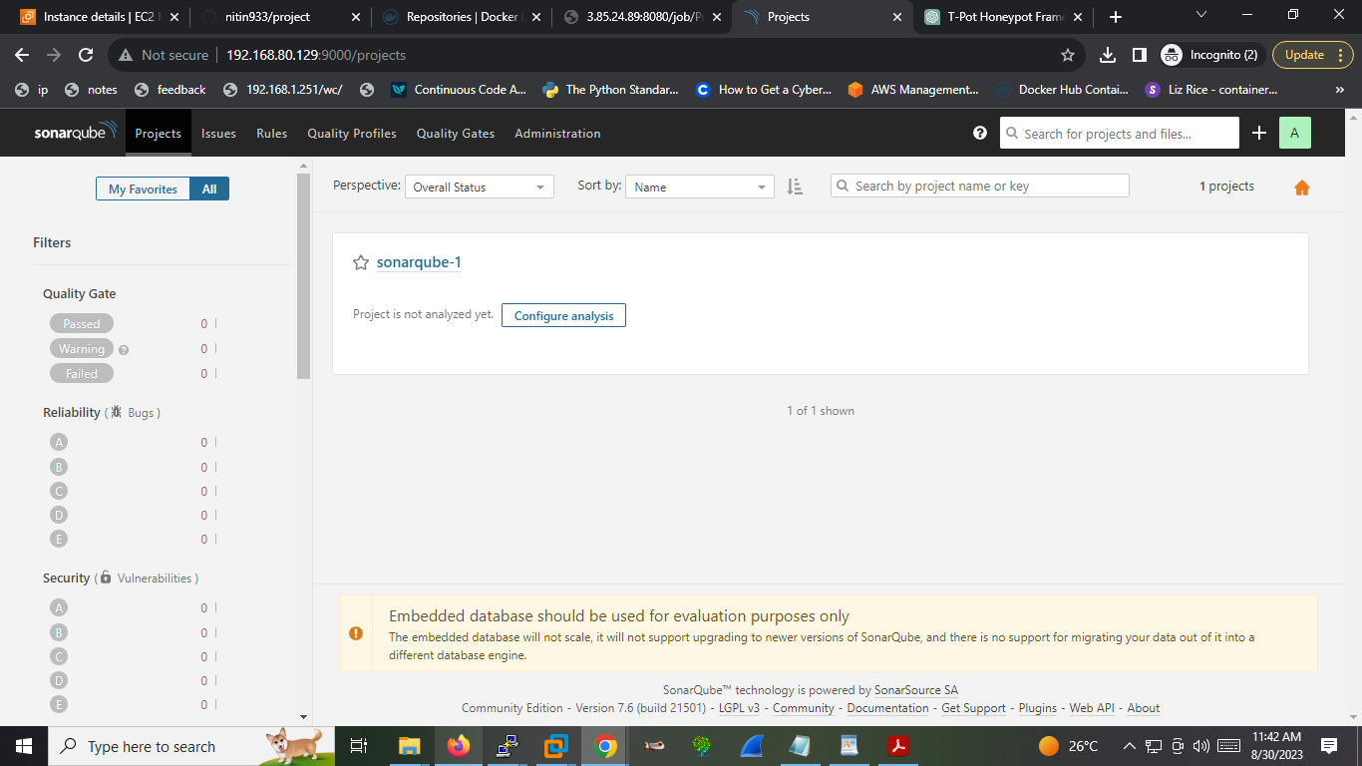

Slide 15
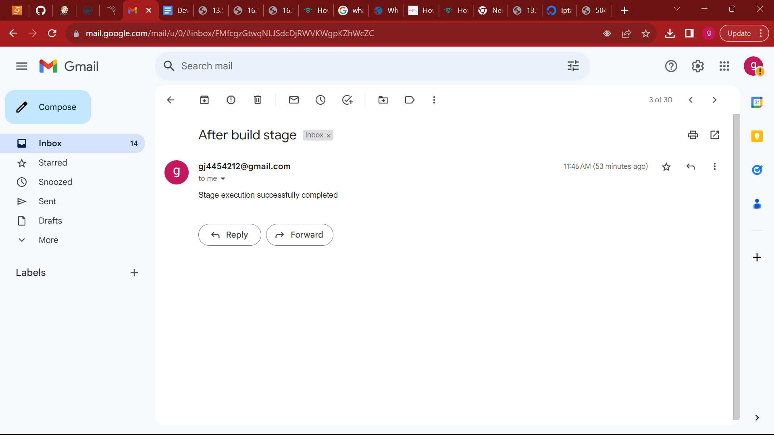

Slide 16
THANK YOU…!

